Slide 1

Powershell - It’s not rocket surgery
BOB BRAZEAu

Slide 2
What is it
PowerShell is an object-oriented programming language and interactive command line shell for Microsoft Windows. PowerShell was designed to automate system tasks, such as batch processing, and create systems management tools for commonly implemented processes.
Or…. Powershell is a powerful scripting language. It is object aware and can be written similar to .Net. It has control flow logic, error handling and is installed by default starting with Windows 7.
Also called PoSH

Slide 3
What can Powershell do for me?
Server Management
Active Directory Integration
Update properties
Read XML files
SQL Server
SQL Jobs can run powershell
Can call Sprocs, t-sql etc
Access file system info
Show failed agent jobs
Personal Project Ideas
bulk rename files
maintain Dropbox folder
assigning Christmas presents
check in to southwest flights
organize photographs on NAS

Slide 4
Tools
Powershell Command Prompt
Powershell ISE
VSCode
Lightweight version of Visual Studio targeted at file editing
Powershell Extension -> View -> Problems
Version control integration - https://code.visualstudio.com/docs/editor/versioncontrol
https://trevorsullivan.net/2017/02/24/use-visual-studio-code-write-powershell/
Install Active Directory module
https://4sysops.com/archives/how-to-install-the-powershell-active-directory-module/

Slide 5
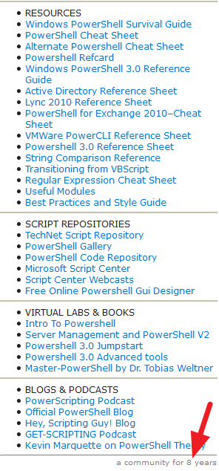
How do I get started?
reddit.com/r/powershell
Stack Overflow
Pluralsight
Microsoft Virtual Academy courses
Book - “Powershell in a month of lunches”
Google/blogs
http://ramblingcookiemonster.github.io/GitHub-For-PowerShell-Projects/
Practice ideas - https://github.com/karan/Projects
Just get your hands dirty and write some code!

Slide 6
Gotchas
Its still a scripting language
Beware of extra data returned when writing functions
Reserved characters. PoSh uses –eq, -ne, -lt, -and, -or
Outdated examples – Version 5 is out, but blogs still have examples using old methods
Sometimes you just have to Run as Admin
So many, there are books of gotchas https://www.gitbook.com/book/devops-collective-inc/the-big-book-of-powershell-gotchas/details

Slide 7
Example time
Failed SQL Server jobs
# script to show SQL Agent failures in last day.
clear-host $logDate = (get-date).AddDays(-1) $instances = "server1", "server2“, “server2\NamedInstance” foreach ($server in $instances) { #could have multiple instances on a server. Split off the instance and create the FQDN $svr = $server.split("\") $svrName = $svr[0] + ".mydomain.com" Get-SqlAgentJobHistory -ServerInstance $svrName, $server -StartRunDate $logDate -OutcomesType Failed | Out-GridView -Title "SQL Agent Error Log for $server“ }
Rename Files
# rename files replacing one term with another. Filters can be applied to restrict what its applied to # For example shorten a prefix on a file in a media folder. Get-ChildItem -Filter “*txt*” -Recurse | Rename-Item -NewName {$_.name -replace ‘Oracle’,’SQL Server’ }
Verify backups https://github.com/bobbrazeau/validate-sql-backups
Examples of file system access, error handling, stored procedure calls
Handling connection timeouts, etc.

Slide 8
Project links and Ideas
DBA Tools – Lots of SQL functions written in powershell
https://dbatools.io/ -> https://github.com/sqlcollaborative/dbatools
Check into Soutwest Flights
https://gallery.technet.microsoft.com/SouthWest-Airlines-e1f861c0
Find duplicate files based on Size + Hash of contents
https://gallery.technet.microsoft.com/scriptcenter/Duplicate-File-Finder-and-78f40ae9
What people in the community have been up to
https://www.reddit.com/r/PowerShell/comments/6evetd/what_have_you_done_with_powershell_this_month_may/
How to read an XML file and access its contents
http://www.tomsitpro.com/articles/powershell-read-xml-files,2-895.html
My Project – Verifying SQL Backups
https://github.com/bobbrazeau/validate-sql-backups
Google> Powershell “thing I want to do”

Slide 9


Questions?

